Slide 1
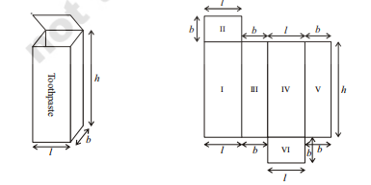
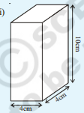
SURFACE AREA
ISOMETRIC
NET
EXAMPLE
DESIGN NOTES
Add the following shapes to this – pyramid, cylinder, hollow cylinder, cone, sphere, hemisphere
Show net and shade the surface area or total surface area depending on what is clicked.
LATERAL SURFACE AREA
Show formula
TOTAL SURFACE AREA
Show formula
Programmer has to calculate values
RESET

Slide 2
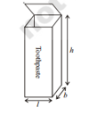
VOLUME
ISOMETRIC
DESIGN NOTES
Add the following shapes to this – pyramid, cylinder, hollow cylinder, cone, sphere, hemisphere
Show net and shade the surface area or total surface area depending on what is clicked.
When you click on cube, the images need to switch to cube
VOLUME
Programmer has to calculate values. SHOW CUBE OR CUBOID BASED ON WHAT IS CLICKED
Show formula

Slide 3

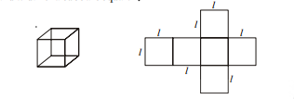
REMOVE THE WORD TOOTHPASTE FROM THE PICTURE
CLICK ON CUBOID – THESE SHAPES HAVE TO APPEAR
WHEN YOU CLICK ON LATERAL SURFACE AREA, ONLY THE LATERAL FACES SHOULD BE SHADED OR GET DIFFERENT COLOR
WHEN YOU CLICK TOTAL SURFACE AREA, ALL FACES SHOULD BE SHADED
FOR LATERAL SURFACE AREA – SHOW FORMULA = 2(l + b) h
FOR TOTAL SURFACE AREA – SHOW FORMULA OF SUFRFACE AREA = 2(l+b)h + 2lb
For SQUARE, LATERAL SURFACE AREA = 4l2( lsquared). Total SURFACE AREA = 6l2 (lsquared)
For both of them show, real world objects – show a rectangular biscuit packet as example for cuboid, rubik cube for cube.
FOR BOTH CUBE & CUBOID, we should be able to replace the l,b,h with values. So, show a cuboid with l = 3, b = 2, and h = 4.

Slide 4
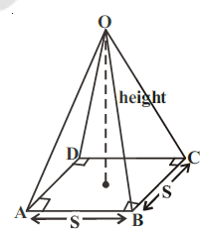
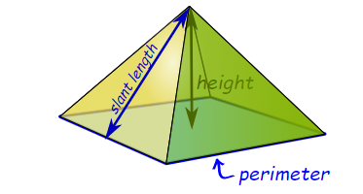
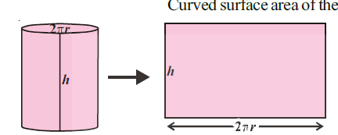
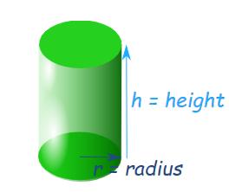
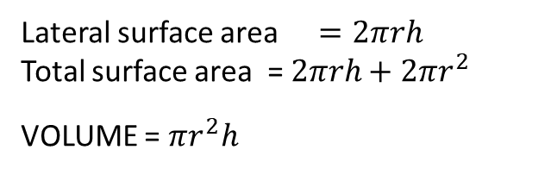
DESIGN NOTES
Add the following shapes to this – pyramid, cylinder, hollow cylinder, cone, sphere, hemisphere
Show net and shade the surface area or total surface area depending on what is clicked.
Lateral surface area = ½ x 4s x l
Total surface area = ½ x 4S x l + S²
VOLUME = 1/3 X S² X h
This is the figure I want you may have to show it isometric (see next fig) , show slant length = l,
Lateral surface area  $=2πrh$
Total surface area = $2πrh+2πr^{2}$
VOLUME = $πr^{2}h$

Slide 5
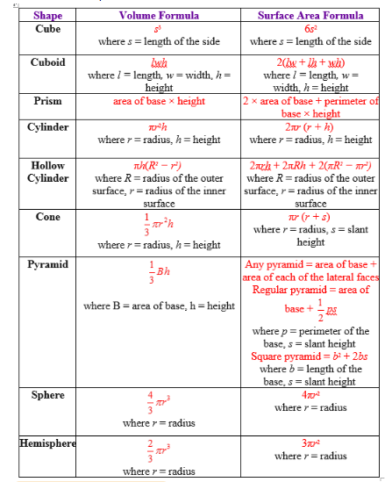
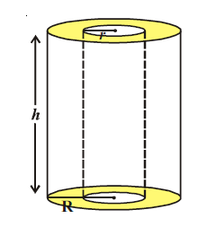


Lateral surface area =
Total surface area
Volume =
note. The right side table gives total surface area formulas. Please create the lateral surface area formulas by removing the top and base. Pyramid and cylinder already done in previous slide

